Slide 1
SAP Data Services Day 5

Slide 2
Day 4 Recap
We covered the following topics in Day 4 :
Data Integrator Transforms
Table Comparison Transform
History Preserving Transform
Key Generation Transform
Date Generation Transform
Pivot Transform (Columns to Rows)
Reverse Pivot Transform (Rows to Columns)

Slide 3
Agenda – Day 5
Error Handling in Data Services
Recovery Mechanism in Data Services
Data Services Performance Tuning Techniques
Data Migration Concept

Slide 4
Error Handling in Data Services
Error handling refers to the anticipation, detection, and resolution of programming, application, and communications errors. For a successful Job, we need to provide a code path, which rectify the different exceptions and continue the job execution.
Error Handling is an important aspect of any ETL tool. BO Data Services has an in-built error-handling and automatic recovery mechanisms in place. Also by using different dataflow designs, we can manually recover a job from a failed execution and ensure proper data in the target.
There are different ways to handle Errors in BODS:
Using Try & Catch
Handling User Defined Exception
Error Handling using Files

Slide 5
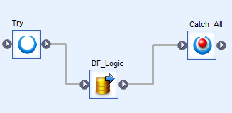
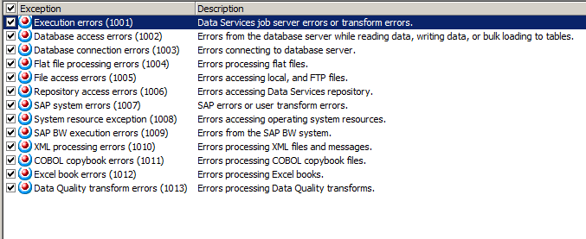
Error Handling Using Try & Catch
A try/catch block is a combination of one try object and one or more catch objects that allow us to specify alternative work flows if errors occur while executing a job.
Catch Exceptions
The following screenshot describes exception groups that we can catch in a try/catch block:

Slide 6
Contd..
Catch scripts
A script is the most common action that a catch executes for a thrown exception. The catch script can contain the following:
· Catch error functions and other function calls
· Nested try/catch blocks
· If statements to perform different actions for different exceptions
Catch error functions
You can only invoke these error functions inside a catch script, a user function, or in an audit script for a data flow.
· error_timestamp() – Returns the timestamp of the caught exception.
· error_context() – Returns the context of the caught exception.
· error_message() – Returns the error message of the caught exception.
· error_number() – Returns the error number of the caught exception.

Slide 7
Error Handling with User Defined Exception
BODS provide two functions to generate User Defined Exception. These functions are :
Raise_Exception:
Calling this function causes an exception to be generated along with the user defined error message, which is provided as a parameter for this function.
Raise_Exception_Ext:
Calling this function causes an exception to be generated along with an exit code.
The work flow or job may or may not be terminated based on whether a try-catch block surrounds the call.

Slide 8
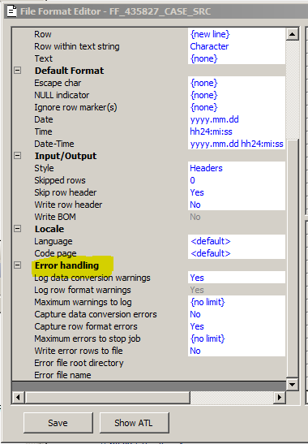
Error Handling using Files
Error handling with the use of Files( as source or target ) can be achieved by:
Error Handling in File Formats:
We can configure the File Format Editor to identify rows in flat-file sources that
contain the following types of errors:
Data Conversion Errors:
Datatype mismatch between file format and data. Suppose a field might be
defined in the File Format Editor as having a data type of integer but the
data encountered is actually varchar.
Row Format Errors: In the case of a fixed-width file, the software identifies
a row that does not match the expected width value.

Slide 9
Contd..
In the File Format Editor, the Error Handling set of properties performs
the following actions on selection:
Log the data-type conversion or row-format warnings to the Error Log.
Limit the number of warnings to log without stopping the job.
Capture or write the errors in the Error File.
Check for either of the two types of source flatfile error
(Data Conversion & Row Format ).
Write the invalid rows to a specified Error file in the Job Server.
Stop processing the source file after reaching a specified number
of invalid row count.
The error file format is a semicolon-delimited text file.

Slide 10
Contd..
Using Error Log:
Error logs help us to determine the reason of job execution failure. The Error log lists errors generated by Data Services, by the source or target DBMS, or the operating system. If the execution completed without error, the Error log is blank. On the other hand Trace logs are used to determine where an execution failed.
Using Get_Error_Log operation:
SAP BusinessObjects Data Services produces several types of log information for a batch job published as a web service. Use the Get_Error_Log operation to retrieve the error log for a batch job.
Using Overflow File in Source:
For Oracle source tables you can use an overflow file for error handling. Select Yes for Use overflow file and enter a name for the file. Errors that occur while reading data are logged into the overflow file and the job execution proceeds while ignoring the rows that cause the error.

Slide 11
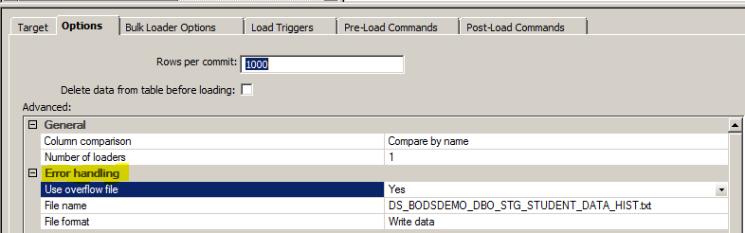
Contd..
Using Overflow File in Target:
If a row cannot be loaded it is written to a file. When this option is set to Yes, options are enabled for the file name and file format.

Slide 12
Recovery Mechanism
A BODS feature that allows to run the unsuccessful jobs in recovery mode. With automatic recovery, the software records the result of each successfully completed step in a job. If a job fails, you can choose to run the job again in recovery mode. During recovery mode, the software retrieves the results for successfully completed steps and reruns uncompleted or failed steps under the same conditions as the original job. For recovery purposes, the software considers steps that raise exceptions as failed steps, even if the step is caught in a try/catch block.
Automatic recovery of job can be achieved by the following methods:
Automatically recovering jobs
Manually recovering jobs using status tables
Ensuring Data is not duplicated in target

Slide 13
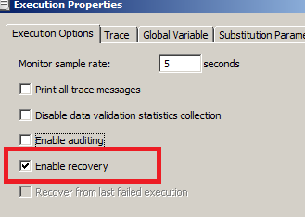
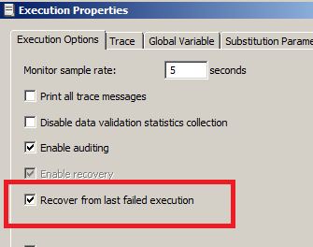
Recovery Mechanism using automatically recovering jobs
Enable recovery
To enable recovery of a batch job, execute it initially with
Enable recovery (execution property) selected.
This selection will prompt the software to record the results of each successful step.
Recover from last failed execution
In case the job fails, rerun the job with this option.
‘Recover from last failed execution’ reruns incomplete or failed steps
under the same conditions as the original job.

Slide 14
Recovery Mechanism using manually recovering jobs using status tables
We need to design the jobs and work flows so that it can manually recover from an unsuccessful run.
A job designed for manual recovery should have certain characteristics:
o We can run the job repeatedly.
o We can implement special steps to recover data when a step did not complete successfully during a previous run.
The above functionality can be achieved by using an execution status table to produce jobs that can be run multiple times without duplicating target rows. The table records the job’s execution status. A “failure” value signals SAP BODS to take a recovery execution path.

Slide 15
Recovery Mechanism while ensuring data is not duplicated in target
To ensure that we do not insert a duplicate row in the target table during recovery (manual or automatic recovery), we need to follow certain design steps as below:
Data Flow Design
The target table can be replaced every time the job is executed. This method is preferred if a significant percentage of the target table rows needs to replaced.
Auto-correct load target table option
If this option is selected, the job server checks for the existing rows in the target table before the new rows are inserted or updated in the target table. The disadvantage of this method is that it slows down the job and hence needs to be used only when a small percentage of the target rows have changed.
Pre-load SQL commands
These can be used to remove partial database updates that have occurred during an incomplete job execution. Typically, the pre-load SQL command deletes rows based on a variable set before the partial insertion began.

Slide 16
Performance Tuning Techniques
The performance of an ETL job depends on the complete system on which you are using Data Services software:
Source Operating System − Source Operating System should be configured to read the data quickly from the disks. Set the read ahead protocol to 64KB.
Source Data Base − Source database should be set to perform the Select statements quickly. This can be done by increasing the size of database I/O, increasing the size of the shared buffer to cache more data and not allowing parallel for small tables, etc.
Target Operating System − Target Operating System has to be configured in order to write the data to the disks quickly. You can turn on Asynchronous I/O to make the Input/output operations as fast as possible.
Target Database − Target Database must be configured to perform INSERT and UPDATE quickly. This can be done by −
Disabling the Archive logging.
Disabling the Redo logging for all tables.
Maximizing the size of the shared buffer.

Slide 17
Contd..
Network − Network bandwidth should be enough to transfer the data from source to target system.
Job Server OS − In Data Services, one data flow in a job initiates one ‘al_engine’ process, which initiates four threads. For maximum performance, consider a design that runs one ‘al_engine’ process per CPU at a time. The Job Server OS should be tuned in such a way that all the threads are spread to all the available CPUs.
DS Repository Database − To improve the performance of DS jobs, the following can be performed −
Monitor Sample Rate − In case you are processing a large amount of data set in an ETL job, set Monitor Sample Rate to a higher value to reduce the number of I/O calls to the log file thereby improving the performance
Use Collect Stats option during first run. These stats can be used for better performance during consecutive runs.
You can also exclude the Data Services logs from the virus scan if the virus scan is configured on the job server as it can cause a performance degradation.

Slide 18
Data Services Performance Tuning
Source-based performance options
Increasing Array fetch size
Caching data
Target-based performance options
Using Bulk Load
Increasing Rows per commit
Number of Loaders
Job design performance options
Using parallel execution of Workflows and Dataflows
Setting value for Degree Of Parallelism (Dataflow) and No. of Loaders (target) as per the availability of the CPUs
Setting the cache type option for Dataflows to In-Memory in case of less data volume
Using Joins in place of lookups as lookup access the table for each and every record which increases the number of I/O operations to database.
Performing Joins between tables of same database
Defining Join Ranks in Query Transform while using Joins
Maximizing the number of pushed-down operations
Minimizing data type conversions as this prevents full pushdown

Slide 19
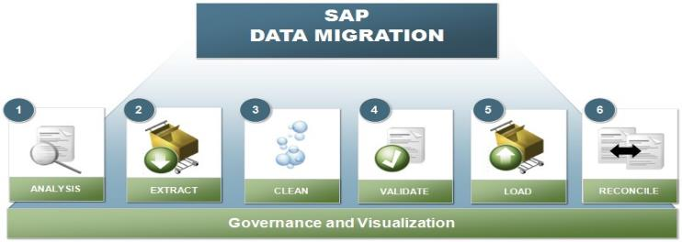
SAP Data Migration Concept

Slide 20
We employ an iterative, 7 step approach to manage data migration
Data Scanning & Profiling
Data Extraction
Data Mapping & Transformation
Data Cleansing & Remediation
Data Validation (Pre)
Data Load
Data Validation (Post)
1
2
3
4
5
6
7
Up-front analysis of current-state master data quality, allowing an accurate assessment of the required data cleansing effort.
Extract current-state data from source systems into a staging area.
Detailed design and definition of how target-state data will be mapped according to Golden Record design.
Cleanse master and operational data required for business go-live.
Validate via simulations and provide business sign-off for the list of data to be loaded back into source systems.
Load data back into source systems. Dependent data will be loaded in sequence while independent data will be loaded in parallel.
Provide business sign-off that data has been successfully loaded. Different levels of validation and reconciliation will be performed, depending on complexity of changes involved.
Iterative

Slide 21
Data Migration Concept
Data Profiling : It helps examine the data available in an existing data source (e.g. a database or a file) and collecting statistics and information about that data. It is used to identify data inconsistencies and problems for data, before it is used for reporting and intelligence purposes.
Data Extraction : Extraction of Master/Transactional data from diverse source systems and can be based on the selection criteria needed for the target system
Data Transformation : It helps to transform the source data into the required target system format
Data Cleansing : It is the process of parsing, standardizing and correction of source data to ensure that the data is clean before loading into the target system
Data Validation : It is used to perform validation in the form of rules and checks to validate if the source data can be loaded into the target system
Data Load : Data Load is used to load the data based to target system
Data Reconciliation : It is used to compare the source and target systems data once the data is migrated into the target system

Slide 22

Q&A

Slide 23
Thank You

